Slide 1


Klang Valley HomeRent: Find Your Perfect Room in Klang Valley
Connecting tenants with ideal room rentals in Malaysia’s vibrant Klang Valley
Notes:
1

Slide 2

The Challenge: Navigating Klang Valley’s Rental Market
Fragmented Listings
Dispersed across various platforms, making a comprehensive search difficult and time-consuming.
Lack of Transparency
Inconsistent information, hidden fees, and unreliable landlord communication create distrust.
Inefficient Matching
Difficulty in finding rooms that truly match specific preferences, budget, and lifestyle needs.
Notes:
2

Slide 3




Who Are We Helping?
Students
Seeking affordable, convenient housing
near campuses.
Young Professionals
Finding well-located rooms close to their
workplaces.
Expatriates
Requiring furnished, hassle-free living
arrangements.
Notes:
3

Slide 4




Our Objective:
Simplify Room Rentals
Easy Search
To provide an intuitive platform that aggregates
verified room listings.
Enhance Trust
To build a transparent ecosystem for both tenants
and landlords
Ensure Satisfaction
To make the room rental process a positive and
stress-free experience
Notes:
4

Slide 5


Why Now? The Driving Force
Urban Migration
Klang Valley's population continues to grow, driving demand for housing.
Digital Shift
Increasing reliance on online platforms for everyday needs, including housing
Market Gaps
Existing platforms often lack specific features tailored to room rentals in Malaysia.
Notes:
5

Slide 6

The Klang Valley HomeRent Solution
Browse & Filter
Easily navigate through listings, applying filters to find rooms based on preferences.
Select & Connect
Once suitable room identified, users gain access to
the agent’s verified contact information
Integrated Chat Assistant
Provide instant support during room-searching
process
Notes:
6

Slide 7




Key Features:
What We Offer
Advanced Search Filters
Location, budget, amenities, flatmates.
Verified Listings
Ensure authenticity with verified landlords and property details, reducing fraudulent listings.
Tenant-Landlord Chat
Direct communication, transparent process.
Notes:
7

Slide 8
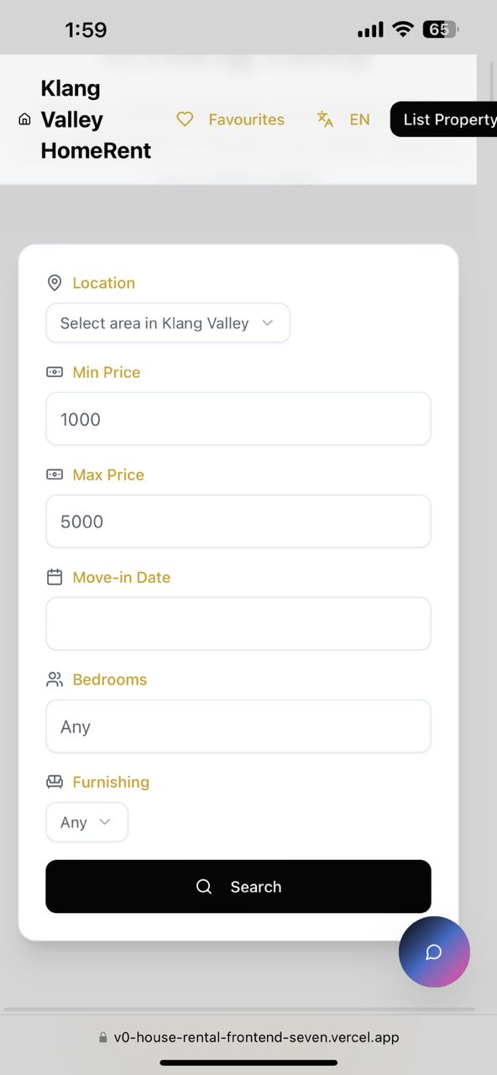
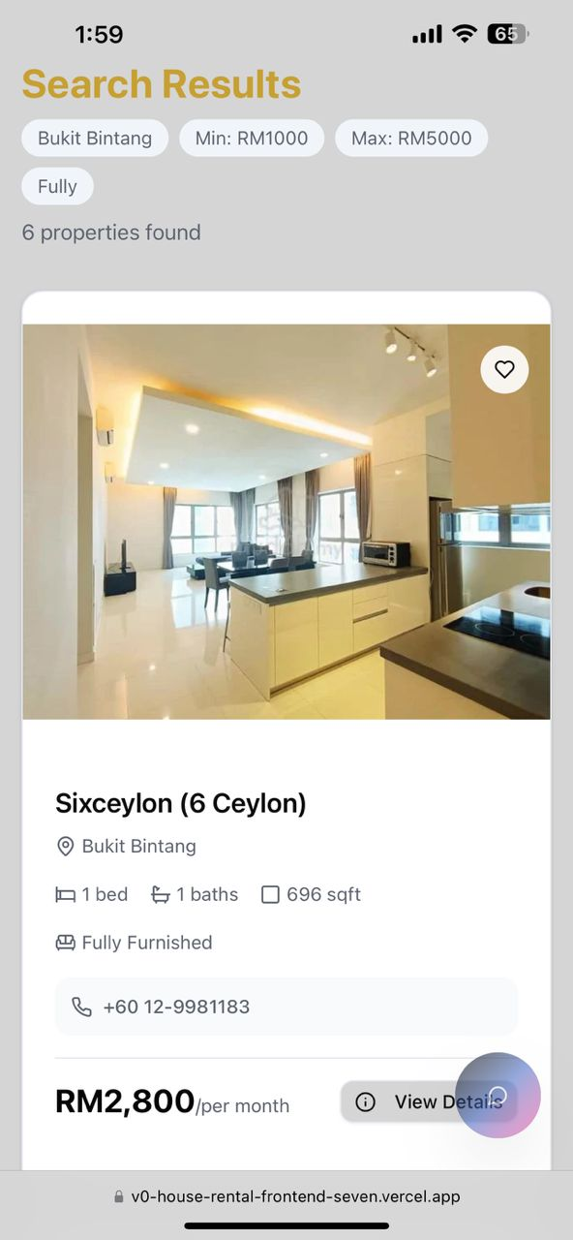
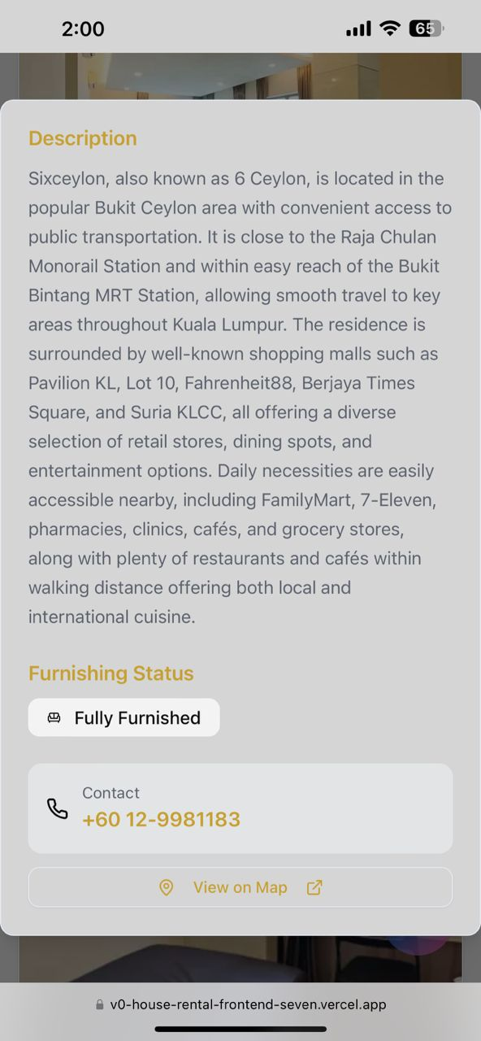
Your Journey with Klang Valley HomeRent
01
Search & Filter
02
View & Connect
03
Book & Secure
Notes:
8

Slide 9

Our Unique Value Proposition
Local Expertise
Deep understanding of Klang Valley.
Tenant-Centric
Prioritising your needs and safety.
Seamless Experience
Technology-driven efficiency.
Notes:
9

Slide 10



Innovation & Differentiation
AI-Powered Matching
Advanced algorithms for perfect matches.
Notes:
10

Slide 11

Innovation & Differentiation
Sustainability Focus
Provide long-term and resource-friendly platform for reliable room rental information.
Notes:
10

Slide 12
Innovation & Differentiation
Blockchain Security
Enhanced trust and data integrity.
Notes:
10

Slide 13

Innovation & Differentiation
Integrated Chat Assistant
Instant guidance, without needing customer service or manual searching
Notes:
10

Slide 14

Conclusion
Klang Valley HomeRent offers reliable and user-friendly platform in Klang Valley, helping all Malaysian find suitable rental rooms with clear listings, smart filters and direct agent contact.

